Slide 1


Alert NYC
Shlok Goswami – sg6862
Utsav Patel – up2023

Slide 2
Introduction
The goal of this project is to clean the data in the dataset, analyze it and provide a descriptive summary.
We have considered NYPD Complaint data historic dataset from NYC Open Data and NYC Neighborhood dataset.
The main step before beginning the project is project formulation where we take the raw data and look for data quality issues.
Project is done using PySpark and PyMongo.

Slide 3
Steps Performed
Data Preprocessing
Data Profiling
Data Cleaning
Datasets Merging
Data Analysis & Visualization

Slide 4
Data Preprocessing
DATA PROFILING:
Used PySpark for this step.
Data preparation requires profiling to gain an understanding of data quality issues, and data manipulation to transform the data into a form that is fit for the intended purpose.

Slide 5
Data Preprocessing
DATA CLEANING:
The main objective of this step is to identify the columns with empty values and extract the most meaningful ones.
Decided to drop some columns (not significant for future data) with high number of null values.
PARKS_NM, STATION_NAME, TRANSIT_DISTRICT, HADEVELOPT, HOUSING_PSA, CMPLNT_TO_DT, CMPLNT_TO_TM were the columns we removed as they had higher percentage of null values.

Slide 6
Continued..
Replaced null values with UNKNOWN.
Modified abbreviations in VIC_SEX and SUSP_SEX columns.
Removed incorrect age groups.
Categorized the offense descriptions into various categories based on the type of offense.
These were certain things we did to clean the dataset.

Slide 7
Datasets Merging
Here, we decided to merge the Neighborhood dataset with the complaints dataset.
Used Haversine to calculate the distance between two points so that it becomes easier for find in which neighborhood the complaint was made based on latitude and longitude.
The idea behind doing this is that we can get the nearest neighborhood for each crime.

Slide 8
Data Analysis
Decided to store the cleaned data into Mongo.
Ran the queries in PyMongo.
Plotted the graphs based on the analysis made.

Slide 9
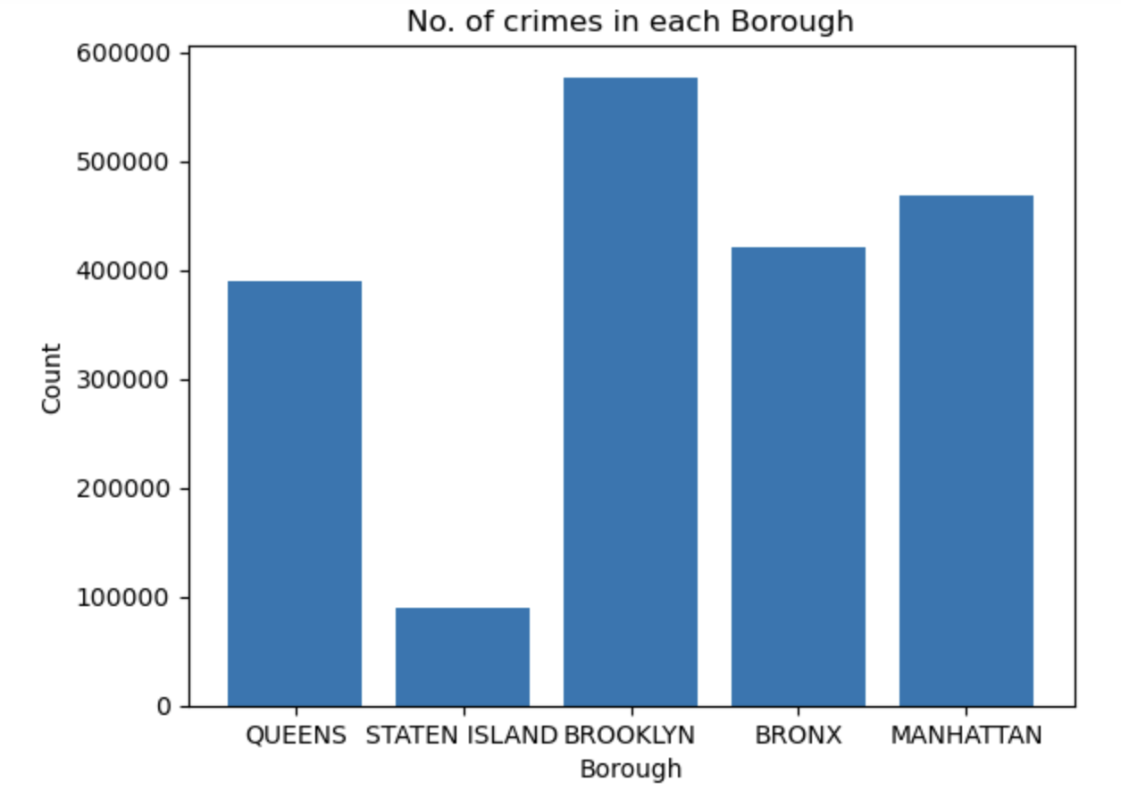
Data Visualization

Slide 10
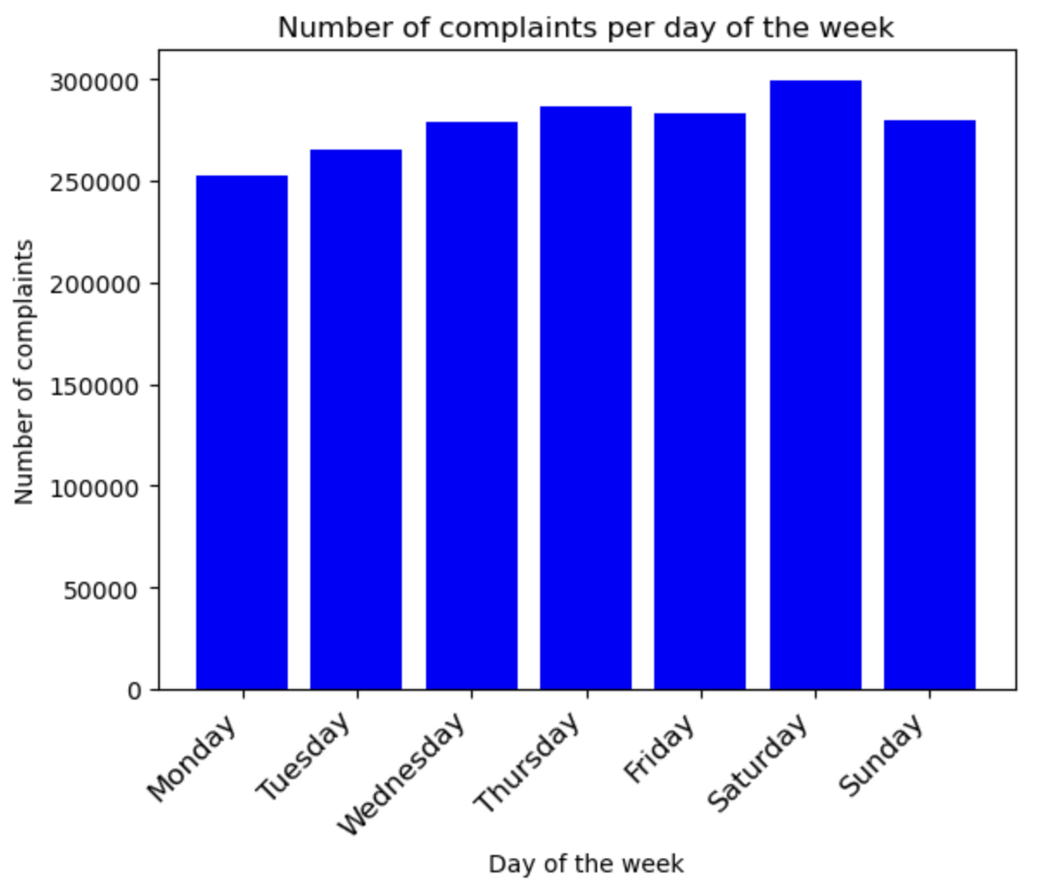
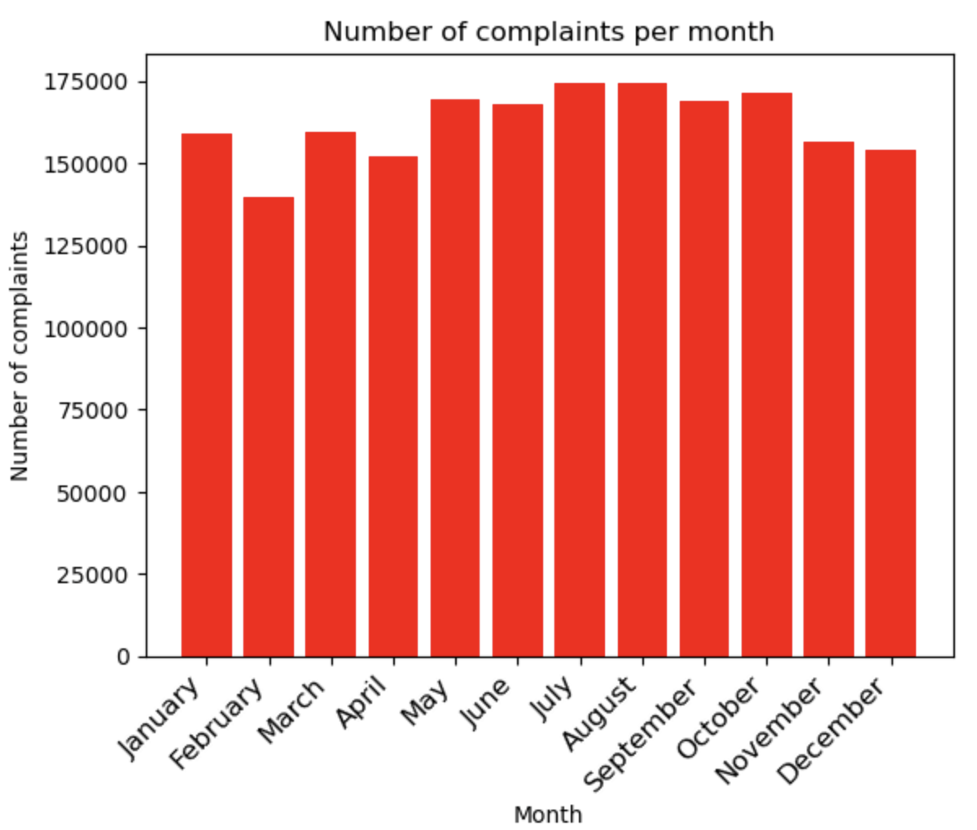
These images show the stats for the no. of complaints

Slide 11
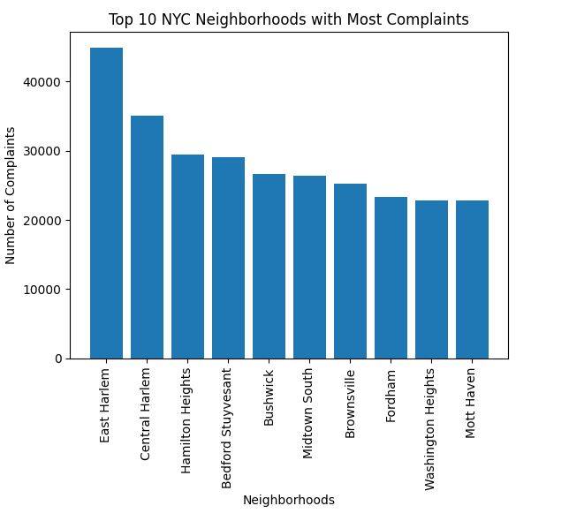
The neighborhoods with most complaints

Slide 12
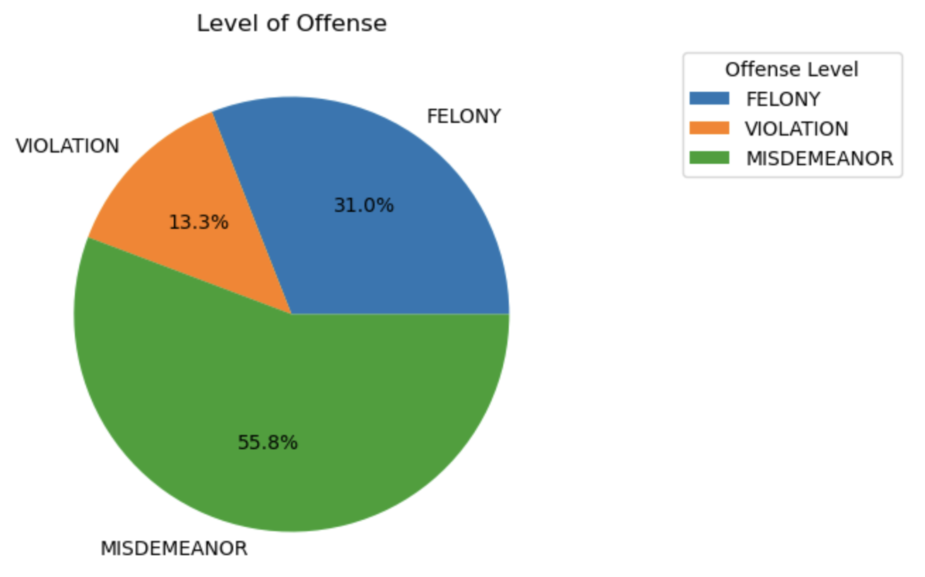
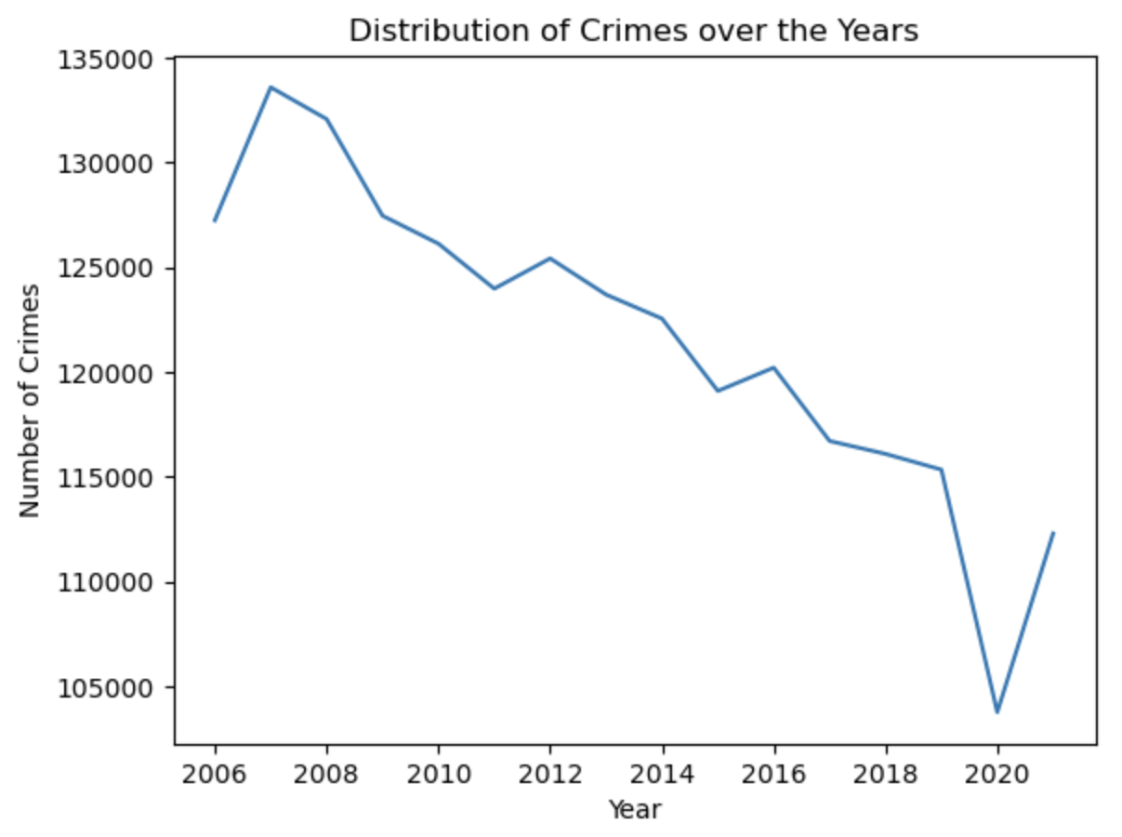

Slide 13
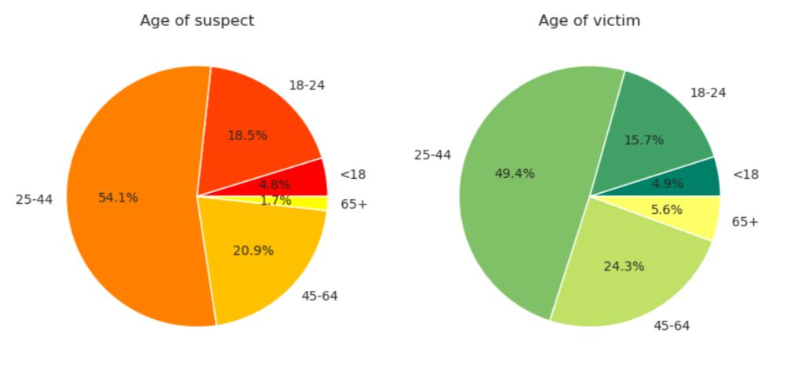

Slide 14
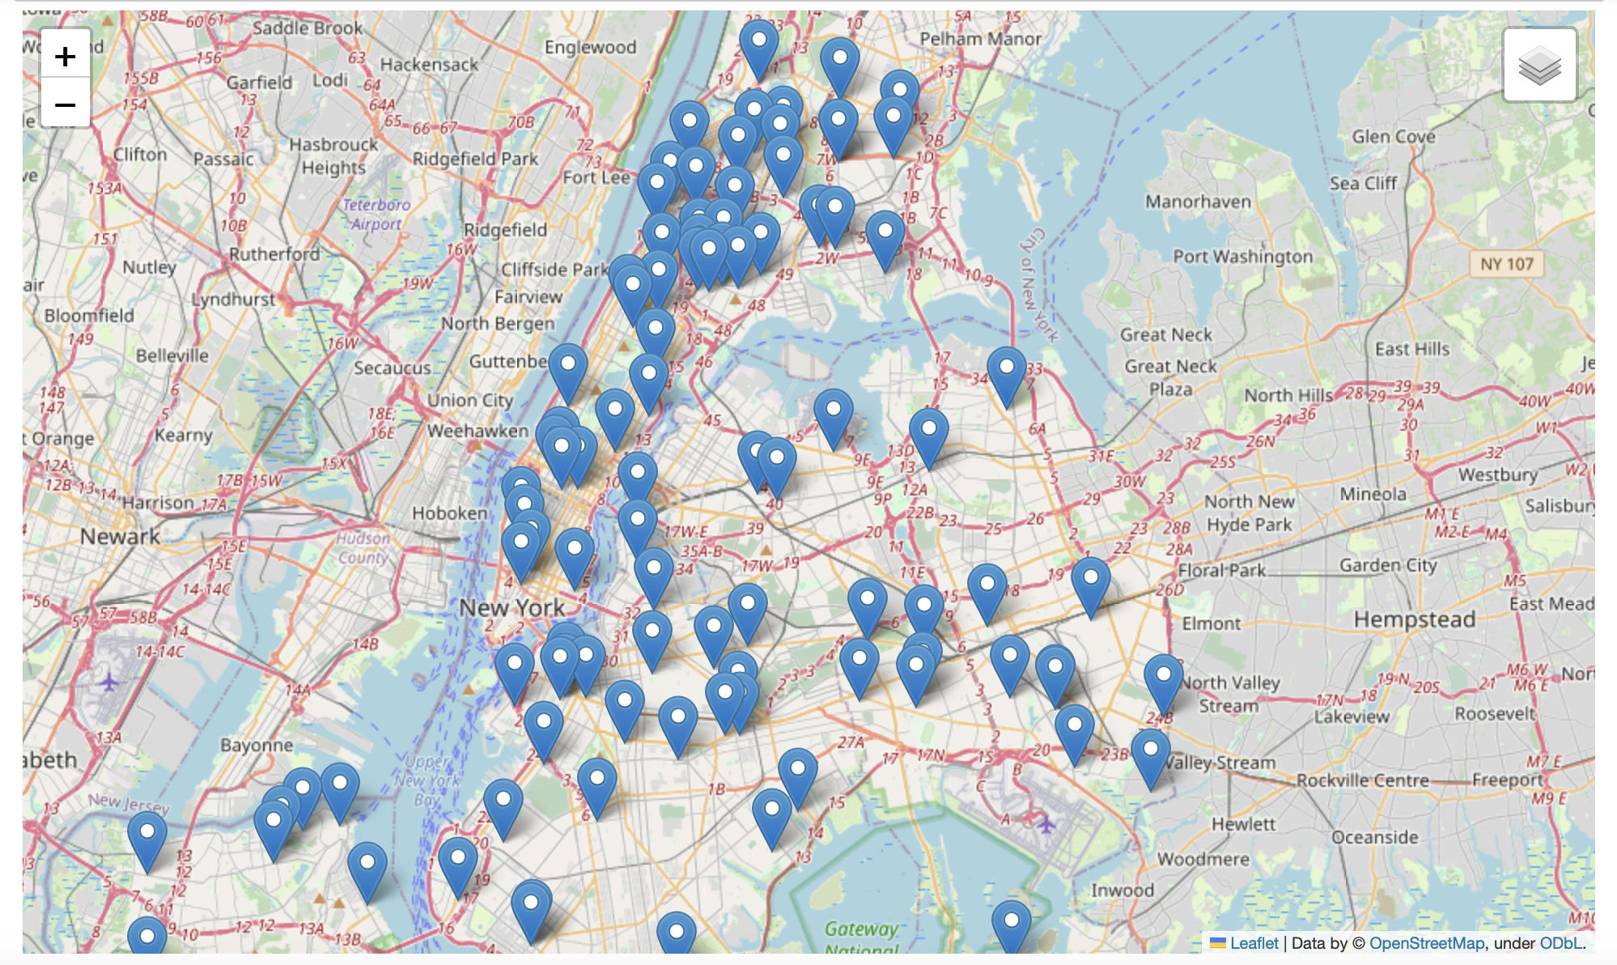
Map Representation of the crimes

Slide 15
Conclusion
Data cleaning and data analysis plays an indispensable role in the knowledge discovery process of extracting interesting patterns or knowledge for understanding various phenomenon.
By finding and understanding the discrepancies in the data we can suggest techniques that will help prospective researchers in analyzing and exploring complaints filed.
Cleaned data can be used for civic action and policy change responsibly to expose the hidden patterns and ideologies

Slide 16
Thank You!

